Slide 1




Supporting Oklahoma Parents with Disabilities
*Major funding for the SPwD Project provided by the Developmental Disabilities Council of Oklahoma

Slide 2
Healthy Bodies – A parents guide on puberty for girls & boys with disabilities from Vanderbilt University (free)
Puberty can be a stressful and confusing time for you and your child with an Intellectual and/or Developmental Disability (I/DD). In spite of delays in other areas, children with I/DD usually enter puberty around the same time as other children their age. Some children with I/DD, including children with spina bifida and cerebral palsy, may start puberty early (called precocious puberty). This toolkit gives you resources and tips on how to talk to your child about these sensitive topics.
The toolkit web version is a pdf version of the printed toolkit that you can print for your reference. Separate toolkits for boys and girls.
The toolkit appendix has storyboards and visuals that you can use in implementing the methods outlined in the toolkit. This file is not included in the printed manual. You may choose to print the entire appendix, or you may want to print a particular page or set of pictures to laminate for everyday use. You may share these pictures with others who work with or care for your child.
https://vkc.mc.vanderbilt.edu/healthybodies/index.html

Slide 3
SAFE: Safety Awareness for Empowerment
Developed by the Waisman Center - University of Wisconsin–Madison
University Center for Excellence in Developmental Disabilities (free)
For youth with special healthcare needs
Covers first aid (a frequent child welfare concern)
Teaches personal safety and healthy relationship skills to prevent victimization and exploitation
https://www2.waisman.wisc.edu/cedd/pdfs/products/health/SAFE.pdf

Slide 4
Women Be Healthy
For training women with disabilities, Women Be Healthy is an 11-week, 22-hour educational curriculum for use by health educators and advocates. The curriculum teaches women with intellectual disabilities about breast and cervical cancer, recommended screenings, and techniques for coping with procedures and assertiveness in medical situations. The goal is to increase access to and receipt of recommended screenings. Women who participated showed significant improvements in health knowledge, behaviors, beliefs and coping strategies. The website also includes links to a series of YouTube videos developed for women with disabilities.
Audience: Health educators, disability advocates and women with disabilities
To learn more, visit http://lurie.brandeis.edu/women/index.html.
Click on the links below to access the YouTube videos:
Mammography: http://www.youtube.com/watch?v=jgTrbWUdclg
Pap Test: http://www.youtube.com/watch?v=s9ylkUuKcXQ&feature=relmfu
Screening Plans: http://www.youtube.com/watch?v=-FER-RCwZNA&feature=relmfu

Slide 5


Teach about healthy relationships

Slide 6
Healthy Start for Me and My Baby
Healthy Start for Me and My Baby is an interactive educational resource designed for pregnant women with learning difficulties. This includes women with intellectual impairment, and women who experience learning difficulties due to lifelong social, educational and health disadvantage.
Healthy Start for Me and My Baby is designed to complement current practice and promote the health and wellbeing of pregnant women with learning difficulties by
providing accessible information about pregnancy and childbirth;
promoting informed choice and participation in health care; and
facilitating better communication with health professionals.
(free) Parent & facilitator PDF copies available by contacting Lisa at lisa-simmons@ouhsc.edu

Slide 7

Parents who have intellectual disabilities
KNOW:
Parents with ID can learn new skills, but it will take more time.
The best strategies are concrete with repetition and generalization built in.
DO:
Get the parent’s attention before you begin to communicate.
Make eye contact and speak directly to the parent.
Use short sentences, 1 topic at a time, 4th grade level.

Slide 8
Be patient - allow plenty of time to respond
Use visuals whenever possible – pictures, schedules, videos, etc.
Do things together – make appointments, enroll, fill out paperwork
Don’t give an assignment – walk through all the steps.
Give specific directions (time, place, addresses, phone numbers) in writing – to them AND their driver if they use one.
Don’t ask yes/no questions, use open ended questions, have them give you an example.
Praise! Tell them all the things they are doing right!!
Build rapport so they will be honest about their barriers.

Slide 9

Area most likely to need support: Communication, Organization, and educational pacing
Communicating with Parents with Learning Difficulties
https://cloudfront.ualberta.ca/-/media/rehabilitation/faculty-site/research/fdsi/documents/practice-points/communicating-with-parents-ld.pdf
Webinar: Working with Parents with Intellectual Disabilities and Their Families: Strategies and Solutions for Social Workers
https://ensemble.brandeis.edu/hapi/v1/contents/permalinks/Gr75RfHc/view

Slide 10
Remember there are lots of ways to learn!
Great info for providers you bring in
Be a great model – don’t just do for them, talk through what you’re doing so they get the “why”
Tell someone verbally (check for understanding - LINK) – provide the handout or written instructions for support person (ask who that is!)
Use “easy read” material – Easy read parenting guides (also can send texts and helpful video links) (LINK)
Use visual steps for a task (to teach & then post as reminder) – bathing the baby (LINK)
Use visual reminders – reading baby/toddler cues (LINK)

Slide 11
Think Visual
Using videos -
  Watch online at link above for repetition
  Videotape yourself on their phone doing it correctly and then they can replay when needed
  videotape parent & child together and then sit down with parent and talk thru what worked and what didn’t

Slide 12
Discover the range of interactive tools, video guides, mobile apps and other products Raising Children Network offers parents and caregivers. Includes:
Our video guide shows common baby cues to help you understand your baby’s body language.
Watch some tricky parent and teen situations and explore how different approaches to communicating can get different results.
Interactive tool to learn how to keep your home safe for kids of different ages.
Explore key child development stages on video, with fun play ideas to boost your child’s learning from birth to eight years.
http://raisingchildren.net.au/interactive_tools/interactive_tools_landing.html
Parenting in Pictures
Articles on lots of basic parenting skills and situations with both words and pictures. Covers all ages.
http://raisingchildren.net.au/parenting_in_pictures/pip_landing_page.html

Slide 13
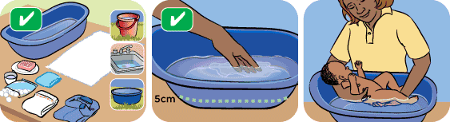
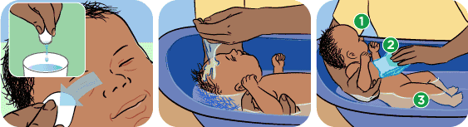

Checking for understanding
Use either/or questions instead of yes/no questions. An example of this is “Did that make you feel happy or sad?”
Include an option of answering “I don’t know” to questions and make sure the parent knows that it is ok to say this
Keep questions short and simple
Use some open-ended questions, e.g., “Tell me what you’ve been doing this week to practice the skills you’ve learnt in this program?”
Avoid statement or questions that have too much detail or are too complex
Ask factual questions that require immediate and concrete answers
Ask the parent to explain a comment you have just made, or to tell you more about it, e.g., “Tell me what it may feel like when labor starts”
Ask for examples to illustrate a comment
Ask how the parent is going to do the task
Use visuals

Slide 14
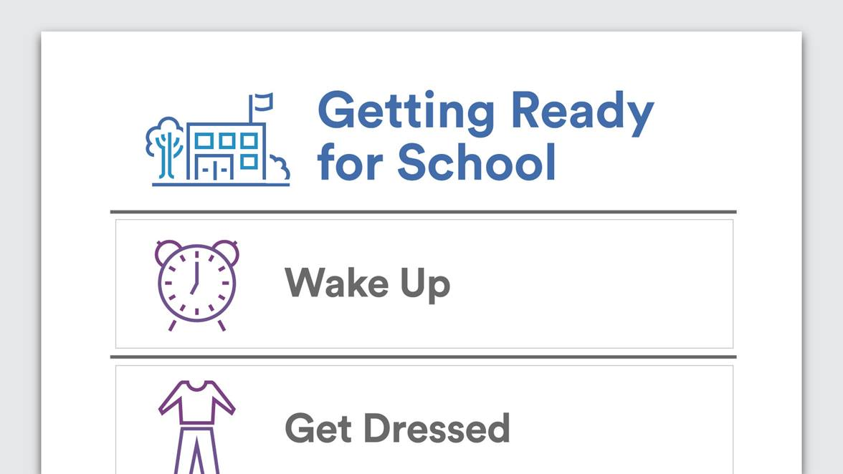

Slide 15
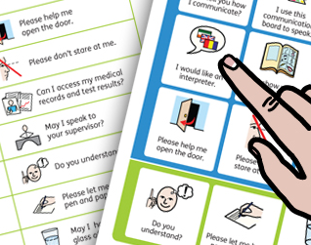
Medical Encounter Board
Medical encounters are fraught with communication pitfalls, and, for patients who have limited ability to speak or have a pre-existing condition limiting their communication capabilities, these pitfalls can be multiplied many times. Such patients need to have communication supports at the ready if and when they are not provided with adequate supports during medical encounters.
This is an easy-to-use and readily available resource for patients with communication vulnerabilities facing medical interactions and covers some of the most important phrases that patients wish to convey during medical visits, in emergency rooms, and in related health settings. (LINK)
https://widgit-health.com/download-files/medical-encounter-board/MEB-grid-A4.pdf
Notes:
This site has lots of different types of simple communication boards that may be helpful.

Slide 16
Managing money
Budgeting for Students with Autism and Learning Differences (Plus Helpful Tips for Parents)
http://info.cipworldwide.org/blog/budgeting-for-young-students-with-autism-and-learning-differences?utm_campaign=Full+Year+Program+Enrollment+2017-2018&utm_source=hs_email&utm_medium=email&utm_content=54669928&_hsenc=p2ANqtz-9KlaZytW8NGtE9cLbW6JF7BWXNocuoxrl3h4GR7mAHIOE-edmtaylMXnKrMdL9TZvUxl57Proh_UeUULs-WZu758-OMg&_hsmi=54670453
Financial Literacy for students with disabilities
https://www.eparent.com/features-3/financial-literacy-students-disabilities-necessary-life-skill-independent-living/

Slide 17
Managing low literacy levels
DO:
If you see behavioral indicators, ask if they have difficulty with certain skills (reading, writing, or math). If they acknowledge a difficulty, ask what helps.
Give them an example with an offer to help “This document can be hard to understand, I’m happy to (read or point out) the things you need to do if that helps you.” (or highlight, bold, enlarge, separate list)

Slide 18
Work smarter, not harder – time vs. tech
Read up on how your approach or materials can be adapted.
For example, for someone who struggles with reading:
Allow them to record you on their phone as you read the intervention plan to them and discuss exactly what they need to do.
Ask if any parenting education they need can be taught using “easy read” materials or computer software that will read the material to them.

Slide 19


This resource offers thousands of activities and training techniques for directly involving parents who are blind, deaf, have physical or learning disabilities, or have cognitive delays with children birth-2 years. Helpful for meeting IEP/IFSP requirements.
Well-illustrated guidebooks are designed to help parents with limited literacy skills foster their children’s self-esteem and language development. Accompanying DVD to use with parents. Available in English or Spanish ($24.95)

Slide 20
Assistive Technology for Parents with Disabilities
http://idahoat.org/Portals/60/Documents/Services/Resources/AT_ParentsHandbook.pdf and
http://idahoat.org/Portals/60/Documents/Services/Resources/AT_CognitiveImpairmentsHandbook.pdf
2 practical guides that offers room by room suggestions for technology that can help with parenting tasks. (LINK)
Source: The Idaho Assistive Technology Project

Slide 21

DigiScan Infrared Talking Thermometer
Helpful for parents with visual impairments
Instantly speaks the temperature results
Red indicator lights when a fever is detected
May also be helpful for a parent with an intellectual disability

Slide 22

Information ….. for you, the parents, their providers & their natural supports
Resource guide for providers supporting parents with disabilities (LINK)
http://soonersuccess.ouhsc.edu/ServicesPrograms/SupportingParentswithDisabilities.aspx
Supporting Oklahoma Parents with
Disabilities (LINK)
https://www.facebook.com/OKpwd/

Slide 23
In your moment of need, call the Parents with Disabilities Resource Team
When presented with a case involving a parent with a disability, the team will:
Help you understand the nature of the parent’s disability.
Discuss how your services can be adapted to meet the parent’s unique needs.
Recommend disability resources that may benefit the family.
Recommend community resources that may benefit the family and discuss ways to make the programs accessible to the parent.
Brainstorm solutions to specific challenges and/or safety concerns that you have about the parent.
Whenever possible, help identify or nurture potential long term supports within the parent’s natural environment or areas of interest.

Slide 24
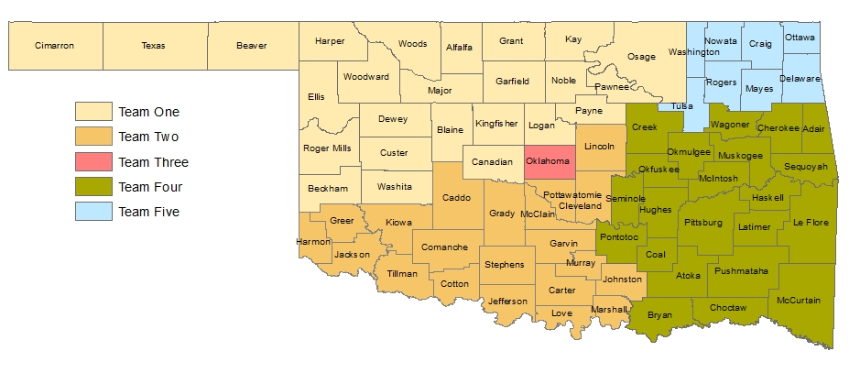
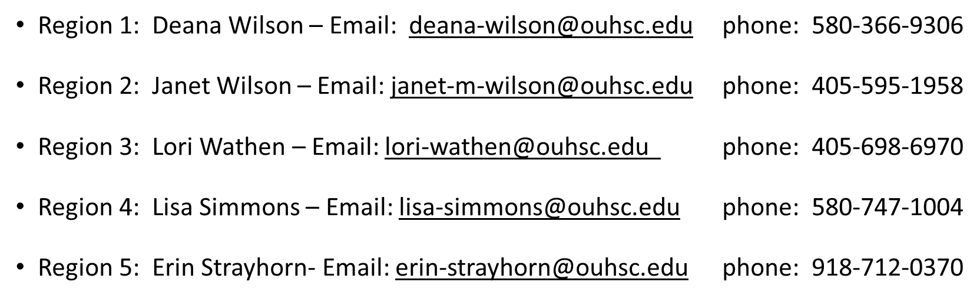
“Moment of Need” We Can Help

Slide 25
Consultation outcomes
88% of providers increased knowledge about the disability in question.
97% of consults identified helpful strategies
84% of consults resulted in increased natural supports for the parent

Slide 26
Advice for professionals from mothers with disabilities
Don't ask [yes/no] questions about how we live. Ask how. 'How do you do X?' versus assume we don't.”
“Presume competence.”
“Understand that there is a long history of mistrust (for good reason) and that you are working within that context.”

Slide 27
“Don't act surprised at our success and our kids’ awesomeness.”
“Listen to all of our concerns instead of being dismissive, disabled moms often have heightened sensitivity levels.”
“Keep an open mind and help find resources instead of assuming [disabled mothers] can't do things.”
Source: National Research Center for Parents with Disabilities, 2017. www.centerforparentswithdisabilities.org

Slide 28

Questions?
Lisa Simmons
Project Coordinator, Supporting Parents with Disabilities
Region 1 Sooner SUCCESS Coordinator
Lisa-simmons@ouhsc.edu
580-747-1004
soonersuccess.ouhsc.edu

