Slide 1




Supporting Oklahoma Parents with Disabilities
*Major funding for the SPwD Project provided by the Developmental Disabilities Council of Oklahoma

Slide 2

Disability facts Sexuality The GYN examination Psychosocial issues GYN Health Screening Contraception Menses and AUB Pregnancy and Parenting BladderBowel Considerations Diet, Weight and Exercise Adolescent Issues Aging and Osteoporosis Mobility disabilities Intellectual and Developmental Disabilities Sensory Disabilities ADA Requirements and Incentives Disability Culture Access and Office Solutions Extensive Resources
This recorded slide program,
Reproductive Health Care for Women with Disabilities assists women's health care clinicians with office skills to assist with their care of women with physical, developmental or sensory disabilities giving specific information for reproductive health care. This program was recorded by Raymond L Cox, Jr., MD, MBA, FACOG and Caroline Signore, MD, MPH, FACOG. Elisabeth Quint, MD, FACOG served as faculty chair.
A Powerpoint presentation with scripted notes is available for download.
:

Slide 3
Part 1 includes an overview of the program, The Scope of Disability in Women, and Psychosocial Issues.
Part 2 includes The GYN Examination, GYN Health Screening, Sexually Transmitted Disease and Skin Examination
Part 3 encompasses Medical and Reproductive Considerations. Modules include: Contraception; Menses and Abnormal Uterine Bleeding; Pregnancy and Parenting; Urinary and Bowel Considerations; Diet, Physical Activity and Weight; Adolescent Health; and Aging and Osteoporosis.
Part 4 encompasses Reproductive Health Specific to Disability. Modules include: Spinal Cord Injury, Spina Bifida, Multiple Sclerosis, Cerebral Palsy, Intellectual and Developmental Disabilities, and Sensory Disabilities.
Part 5 encompasses Access to Health Care. Modules include: ADA Requirements and Incentives, Disability Culture, and Universal Design/Office Practice Solutions
Part 6 is the Resources Section with links to resources for providers, patients and those who care for them.
Found online at:
http://www.acog.org/About-ACOG/ACOG-Departments/Women-with-Disabilities/Interactive-site-for-clinicians-serving-women-with-disabilities

Slide 4

Parents who have physical disabilities
KNOW:
Can be mild or cause significant limitations to movement, strength, and endurance.
Usually requires the use of assistive technology and environmental modification.
DO:
Respect wheelchairs and walkers as part of the parent’s personal space.
Sit or stand at the level of the parent when speaking.
Offer help, then respect their yes, no, and how much.

Slide 5
Be aware of crowded and rough spaces
Be aware of space when pushing people using a wheelchair
  Let them know that you are ready to push.
  Watch other people to avoid clipping their heels.
  Avoid sudden turns or speed changes
  Carefully watch for changes in levels and pavement cracks and potholes.
  For steps, steep ramps, or curbs, ask wheelchair users how they would like to proceed.
Make sure you chose an accessible space to meet with them.
Educate yourself about any assistive technology or equipment they use and way their home has been modified for their use.

Slide 6

Area most likely to need support: Navigating unfamiliar spaces, reaching objects, child safety
Disability Etiquette – practical tips to help you accommodate different types of physical disabilities
https://www.unitedspinal.org/pdf/DisabilityEtiquette.pdf
Assistive Technology for Parents with Disabilities – Room by room
http://idahoat.org/Portals/60/Documents/Services/Resources/AT_ParentsHandbook.pdf

Slide 7

This resource offers thousands of activities and training techniques for directly involving parents who are blind, deaf, have physical or learning disabilities, or have cognitive delays with children birth-2 years. Helpful for meeting IEP/IFSP requirements.

Slide 8
Transportation
The Dan Lutz Rehabilitative Driving Services, L.L.C., is now a privately owned driving program housed on the campus of the University of Central Oklahoma (UCO) in Edmond, Oklahoma. The program offers driver training, assessment, and evaluation services for individuals with disabilities. Ph: 405-834-3877
Parents with Disabilities: Using Public Transportation with Your Child.
https://www.facebook.com/lookingglass.org/videos/10153735663691656/
Embark Plus – OKC door to door transportation (must apply) for those with documented physical or cognitive disability
https://embarkok.com/learn/services/plus

Slide 9

Oklahoma ABLE Tech
800-257-1705
https://www.okabletech-abc.org/

Slide 10
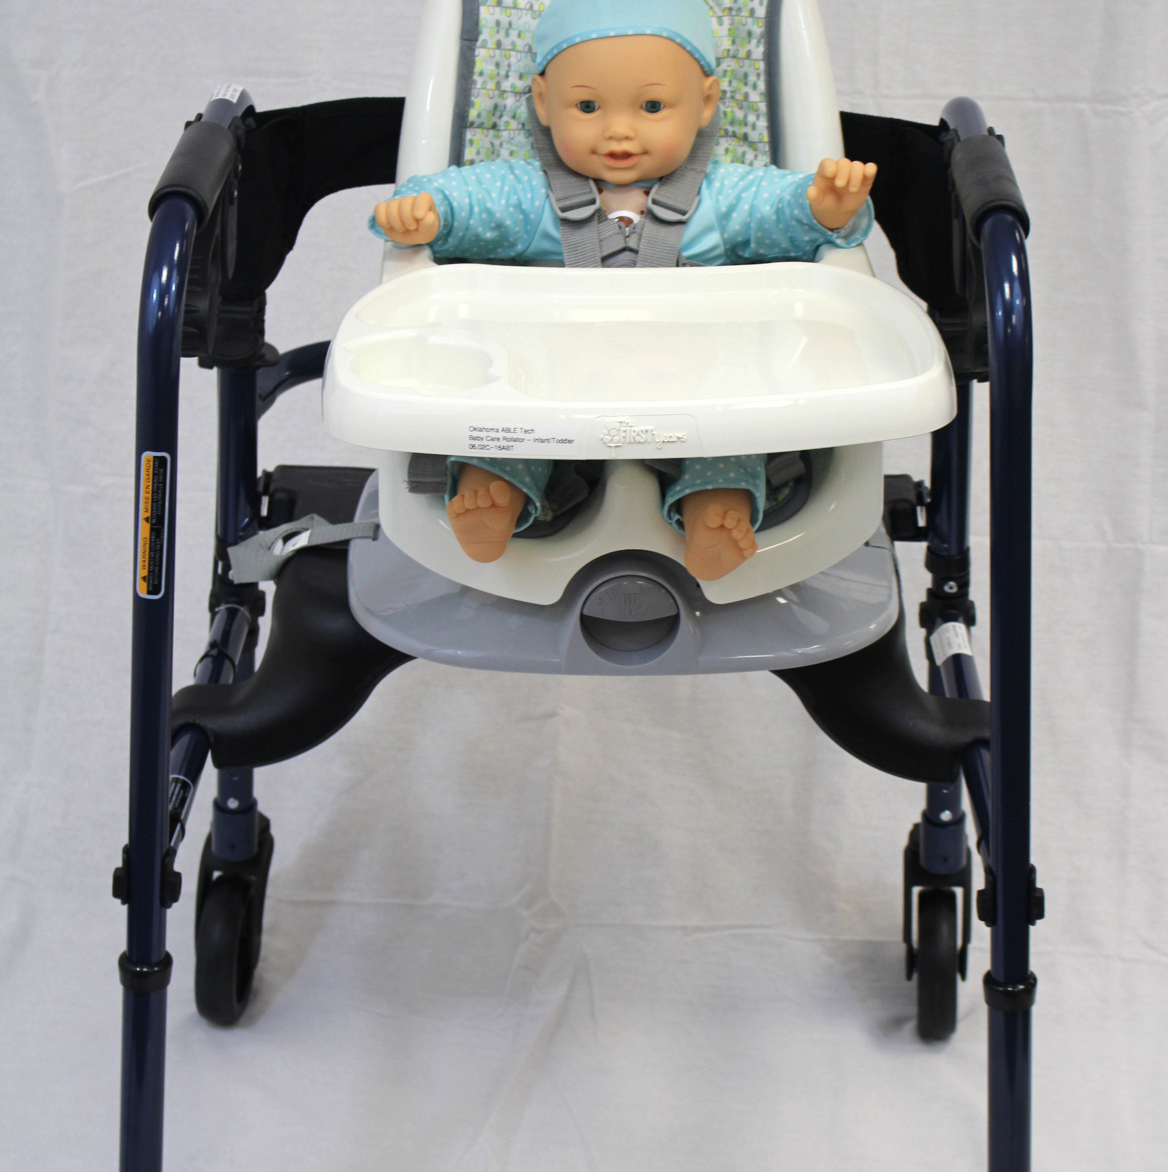
Baby Care Rollator – with feeding seat
Rollator walker with a feeding seat attached.
Useful for parents who have difficult carrying their child
Baby can be placed securely in the seat while parents use the walker for support as they walk.
For newborn children, a rollator with a bouncy seat attached is available.

Slide 11
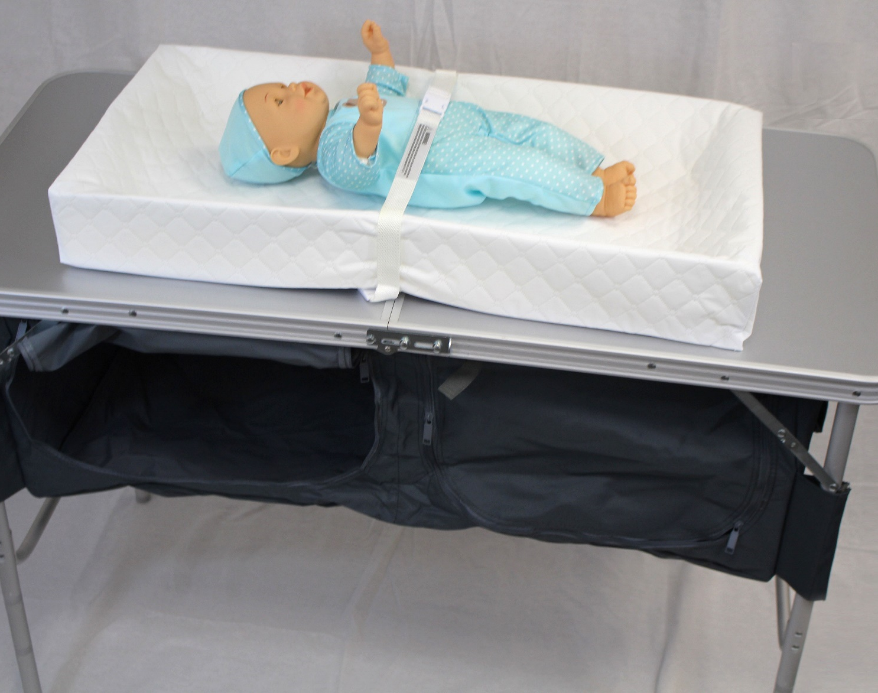
Adapted Changing Table
A height-adjustable table to accommodate the need to sit while changing diapers.
The storage compartment can be used to store diapering supplies or can be removed if it hinders parents from rolling a wheelchair up under it.

Slide 12
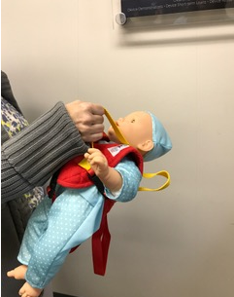
Lifting Harness
Helpful for a parent that has limitations in upper extremities such as decreased hand strength and hand grasp
Provides an easier and safer way to lift a child

Slide 13

Infant Pacifier Thermometer
Helpful for parents who are unable to physically hold a thermometer in place
May also be helpful for a parent with an intellectual disability

Slide 14
Adapted Baby Crib
Helpful for parents with decreased mobility and other physical limitations such as back pain.
Crib is modified so that the front gate slides
Height of crib is raised so that a parent in a wheelchair can roll directly to the edge of the crib and safely transfer an infant or toddler between the crib and their lap

Slide 15
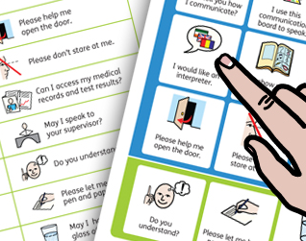
Medical Encounter Board
Medical encounters are fraught with communication pitfalls, and, for patients who have limited ability to speak or have a pre-existing condition limiting their communication capabilities, these pitfalls can be multiplied many times. Such patients need to have communication supports at the ready if and when they are not provided with adequate supports during medical encounters.
This is an easy-to-use and readily available resource for patients with communication vulnerabilities facing medical interactions and covers some of the most important phrases that patients wish to convey during medical visits, in emergency rooms, and in related health settings. (LINK)
https://widgit-health.com/download-files/medical-encounter-board/MEB-grid-A4.pdf
Notes:
This site has lots of different types of simple communication boards that may be helpful.

Slide 16
Assistive Technology for Parents with Disabilities
http://idahoat.org/Portals/60/Documents/Services/Resources/AT_ParentsHandbook.pdf and
http://idahoat.org/Portals/60/Documents/Services/Resources/AT_CognitiveImpairmentsHandbook.pdf
2 practical guides that offers room by room suggestions for technology that can help with parenting tasks. (LINK)
Source: The Idaho Assistive Technology Project

Slide 17
In your moment of need, call the Parents with Disabilities Resource Team
When presented with a case involving a parent with a disability, the team will:
Help you understand the nature of the parent’s disability.
Discuss how your services can be adapted to meet the parent’s unique needs.
Recommend disability resources that may benefit the family.
Recommend community resources that may benefit the family and discuss ways to make the programs accessible to the parent.
Brainstorm solutions to specific challenges and/or safety concerns that you have about the parent.
Whenever possible, help identify or nurture potential long term supports within the parent’s natural environment or areas of interest.

Slide 18
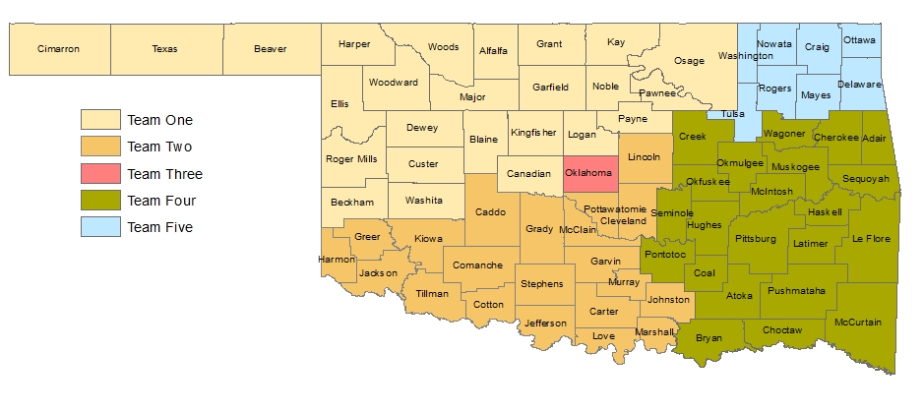
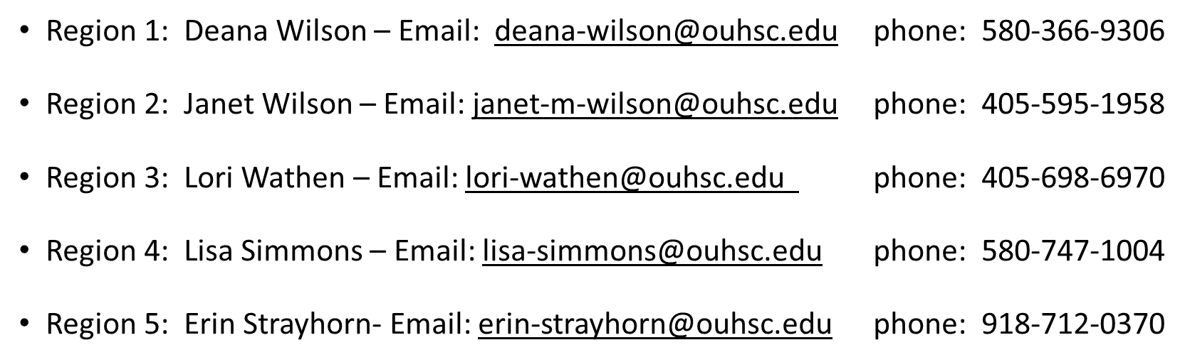
“Moment of Need” We Can Help

Slide 19
Consultation outcomes
88% of providers increased knowledge about the disability in question.
97% of consults identified helpful strategies
84% of consults resulted in increased natural supports for the parent

Slide 20

Information ….. for you, the parents, their providers & their natural supports
Resource guide for providers supporting parents with disabilities (LINK)
http://soonersuccess.ouhsc.edu/ServicesPrograms/SupportingParentswithDisabilities.aspx
Supporting Oklahoma Parents with
Disabilities (LINK)
https://www.facebook.com/OKpwd/

Slide 21
Advice for professionals from mothers with disabilities
Don't ask [yes/no] questions about how we live. Ask how. 'How do you do X?' versus assume we don't.”
“Presume competence.”
“Understand that there is a long history of mistrust (for good reason) and that you are working within that context.”

Slide 22
“Don't act surprised at our success and our kids’ awesomeness.”
“Listen to all of our concerns instead of being dismissive, disabled moms often have heightened sensitivity levels.”
“Keep an open mind and help find resources instead of assuming [disabled mothers] can't do things.”
Source: National Research Center for Parents with Disabilities, 2017. www.centerforparentswithdisabilities.org

Slide 23

Questions?
Lisa Simmons
Project Coordinator, Supporting Parents with Disabilities
Region 1 Sooner SUCCESS Coordinator
Lisa-simmons@ouhsc.edu
580-747-1004
soonersuccess.ouhsc.edu

