Slide 1




Supporting Oklahoma Parents with Disabilities
*Major funding for the SPwD Project provided by the Developmental Disabilities Council of Oklahoma

Slide 2

Parents who are deaf or hearing impaired
KNOW:
Deafness is complete hearing loss. Hearing impaired varies in extent of loss.
Hearing aids increase volume, not necessarily clarity.
DO:
Get the parent’s attention before you begin to communicate. Lightly touch people on the arm or flick the lights when entering an area to get the parent’s attention.
Make eye contact and speak directly to the parent NOT their interpreter.
Ask how they want to communicate – sign language, lip reading, writing notes, etc.

Slide 3
Be patient with yourself and the parent
Keep your face in the light.
Speak slower if you tend to talk fast.
Keep sentences short and simple.
Give specific directions (time, place, addresses, phone numbers) in writing.
Eliminate interruptions as much as possible, explain if necessary.
Keep pen and paper handy.
When in groups, sit in a circle and speak 1 at a time.

Slide 4

Area most likely to need support: Communication
Find a sign language interpreters at:
https://okrid.org/resources/

Slide 5

Parents who have visual impairments
KNOW:
Blind is complete loss. Visually impaired is a spectrum.
Some people who are blind use braille, most do not.
DO:
Always introduce yourself and anyone else present for the conversation. Identify who you are and what your job or role is.
A white cane or guide dog are part of the person’s personal space.
Explain changes in the environment, sound may not be enough.

Slide 6
Explain changes in the environment. Sounds may not be enough.
Don’t assume your help is needed
  Offer and then wait for their response.
  If asked to help, offer your arm and let them take your elbow.
  Never leave them standing alone in the middle of the room.
  Escort to a chair or point of reference.
In a group, everyone should identify themselves before they speak.
Give information verbally – read paperwork aloud, announce when group information is put up for visual review and read it to them.
Describe things from their perspective, not yours. Some persons who are blind use a "clock" reference for things directly in front of them such as a meal. For example, something could be positioned at three o'clock (to their right) or six o'clock (directly in front and close). Before using this strategy, ask the person if this is useful to them.

Slide 7
What are auxiliary aids and services? What does it mean to provide effective communication?
The ADA includes the provision of appropriate auxiliary aids and services – where necessary to ensure that individuals with communication disabilities understand what is said or written and can communicate as effectively as individuals without disabilities.
Examples of auxiliary aids and services include, among others, qualified interpreters, note takers, computer-aided transcription services, accessible electronic and information technology, written materials, telephone handset amplifiers, assistive listening devices, assistive listening systems, telephones compatible with hearing aids, closed caption decoders, open and closed captioning, telecommunications devices for deaf persons (TDD’s), videotext displays, qualified readers, taped texts, audio recordings, braille materials, large print materials, and modifications to existing devices.
What is needed may vary over time or by situation. For example, a qualified interpreter may be necessary for smaller settings involving only a few people, such as home visits or assessments, whereas the use of real-time captioning may be appropriate during larger group meetings, such as family team meetings or in court, where numerous people are present or where the layout of the room makes it difficult to view an interpreter and obtain visual cues from the speaker. However, to communicate a simple message such as an appointment date or address, handwritten notes may be sufficient.

Slide 8
Guidelines
In order to be effective, auxiliary aids and services must be provided in a timely manner and in such a way as to protect the privacy and independence of the individual with a disability.
Individuals with disabilities cannot be required to supply their own interpreters or other auxiliary aids and services.
Minor children accompanying individuals with disabilities cannot be asked to interpret, except in emergencies involving imminent threats to the safety or welfare of an individual or the public where no interpreter is available.
Adults accompanying individuals with disabilities can be asked to interpret, but only in emergencies or where the individual with a disability specifically makes such a request, the accompanying adult agrees to provide such assistance, and reliance on that adult for such assistance is appropriate under the circumstances.
State and local agencies and courts are prohibited from placing a surcharge on a particular individual with a disability or any group of individuals with disabilities to cover the costs of the provision of auxiliary aids or other services that are required to provide that individual or group with nondiscriminatory treatment.

Slide 9
Areas most likely to need support: Navigating unfamiliar spaces; accessing adaptive equipment; safety
Parenting without Sight: What Attorneys, Social Workers, and Parents Should Know about Blindness
https://nfb.org/Images/nfb/Publications/brochures/BlindParents/ParentingWithoutSight.html
Oklahoma ABLE Tech
Toll Free: (888) 885-5588 or http://okabletech.okstate.edu/
Visually impaired parents raising sighted children
http://www.vickieparkermft.com/viparents.php

Slide 10

Oklahoma ABLE Tech
800-257-1705
https://www.okabletech-abc.org/

Slide 11
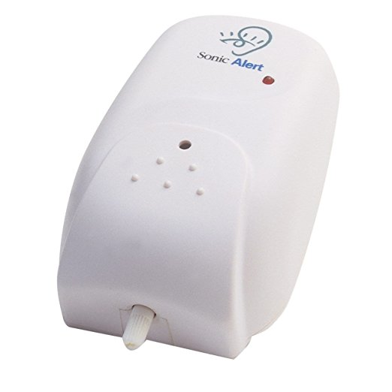
Baby Cry Signaler
Helpful for parents who are deaf or hearing impaired
Alerts parents to a baby’s cry and can be adjusted to alert for quieter noises as well
Provides a signal that the parent can receive through visual or tactile senses

Slide 12
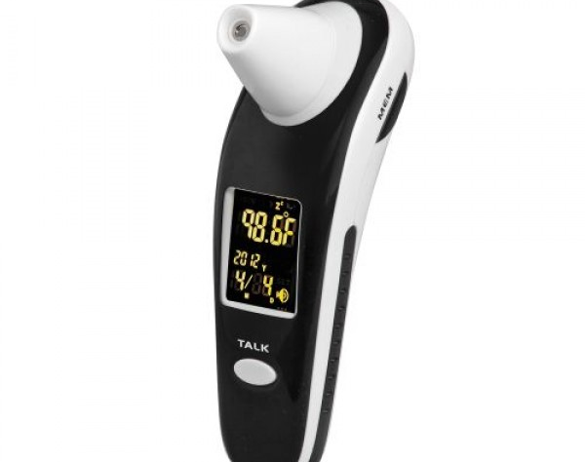
DigiScan Infrared Talking Thermometer
Helpful for parents with visual impairments
Instantly speaks the temperature results
Red indicator lights when a fever is detected
May also be helpful for a parent with an intellectual disability

Slide 13
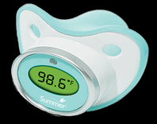
Infant Pacifier Thermometer
Helpful for parents who are unable to physically hold a thermometer in place
May also be helpful for a parent with an intellectual disability

Slide 14
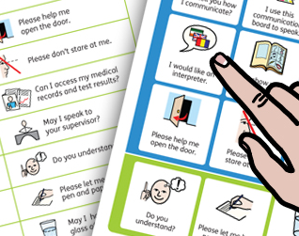
Medical Encounter Board
For patients who have limited ability to speak
Have communication supports at the ready if and when they are not provided during medical encounters.
This is an easy-to-use and readily available resource for patients with communication vulnerabilities facing medical interactions.
Covers some of the most important phrases that patients wish to convey during medical visits, in emergency rooms, and in related health settings.
https://widgit-health.com/download-files/medical-encounter-board/MEB-grid-A4.pdf
Notes:
This site has lots of different types of simple communication boards that may be helpful.

Slide 15

This resource offers thousands of activities and training techniques for directly involving parents who are blind, deaf, have physical or learning disabilities, or have cognitive delays with children birth-2 years. Helpful for meeting IEP/IFSP requirements.

Slide 16
National Research Center for Parents with Disabilities, 2017. www.centerforparentswithdisabilities.org
Provides fact sheets and webinars designed specifically for parents with disabilities, prospective parents with disabilities, social workers, and lawyers. Lots of practical information
Know Your Rights: Advocacy Strategies for Parents with Disabilities
Deaf Parents' Approaches to Parenting
How Prospective Parents with Disabilities Can Prepare for Parenthood
Family Mental Health Begins with Parents
Working with Parents with Intellectual Disabilities and Their Families: Strategies and Solutions for Social Workers
Representing Parents with Intellectual Disabilities and their Families: Strategies and Solutions for Attorneys

Slide 17
In your moment of need, call the Parents with Disabilities Resource Team
When presented with a case involving a parent with a disability, the team will:
Help you understand the nature of the parent’s disability.
Discuss how your services can be adapted to meet the parent’s unique needs.
Recommend disability resources that may benefit the family.
Recommend community resources that may benefit the family and discuss ways to make the programs accessible to the parent.
Brainstorm solutions to specific challenges and/or safety concerns that you have about the parent.
Whenever possible, help identify or nurture potential long term supports within the parent’s natural environment or areas of interest.

Slide 18
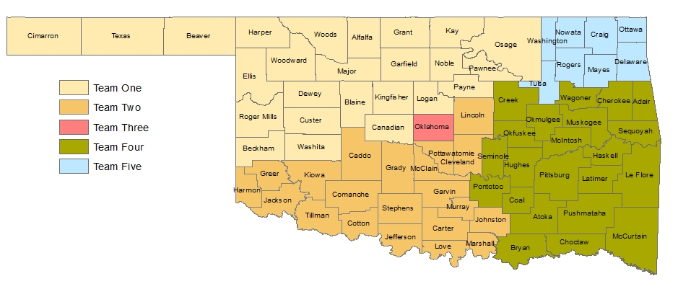
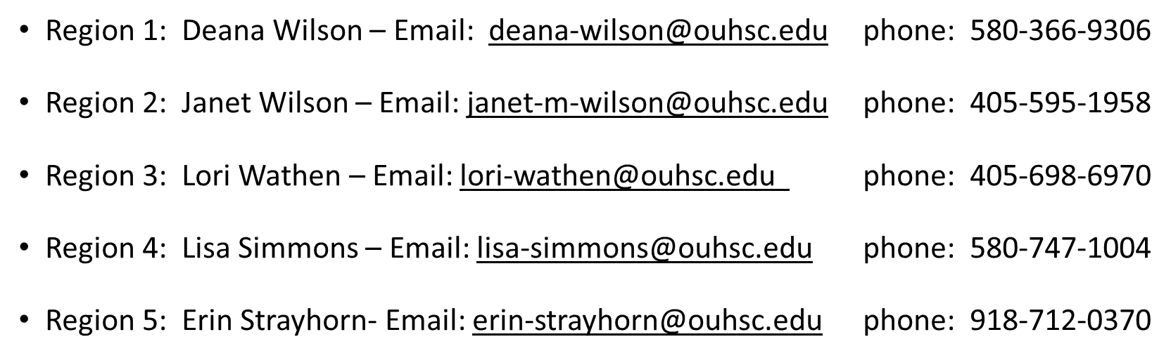
“Moment of Need” We Can Help

Slide 19
Consultation outcomes
88% of providers increased knowledge about the disability in question.
97% of consults identified helpful strategies
84% of consults resulted in increased natural supports for the parent

Slide 20

Information ….. for you, the parents, their providers & their natural supports
Resource guide for providers supporting parents with disabilities (LINK)
http://soonersuccess.ouhsc.edu/ServicesPrograms/SupportingParentswithDisabilities.aspx
Supporting Oklahoma Parents with
Disabilities (LINK)
https://www.facebook.com/OKpwd/

Slide 21

Questions?
Lisa Simmons
Project Coordinator, Supporting Parents with Disabilities
Region 1 Sooner SUCCESS Coordinator
Lisa-simmons@ouhsc.edu
580-747-1004
soonersuccess.ouhsc.edu

