Slide 1



Supporting Oklahoma Parents with Disabilities
Major funding for the Supporting Parents with Disabilities Project provided by the Oklahoma Developmental Disabilities Council

Slide 2
How many parents in Oklahoma have a disability?
Source: Kaye, H. Steven. Current Demographics of Parents with Disabilities in the U.S. Berkeley, CA: Through the Looking Glass, 2012 (Oklahoma data is from 2008-2009)

Slide 3
Why this matters
35,900
In DDS services – you have parents and those who want to be
Parenting is parenting
  Supervised visitation
  Weekend visits with kinship placements
  Partial custody
  Full custody
Parenting skills can be taught and YOU are teachers
What about those you serve who WANT to be parents

Slide 4
How you can help
What skills would help them parent more effectively in their current situation?
  Babycare skills
  Age appropriate Interaction skills
  How to make a healthy meal or snack
  How to use public transportation with a child
  How to supervise a child and ensure safety
  What limits their interactions with their child

Slide 5
For those who want to be parents……
What skills are you building in adults who want to have a partner and be a parent?
  Making friends
  Personal safety
  Healthy relationships
  Safe sex
  Birth control
  Building a support network

Slide 6
Your Action Plan
Put it in the plan and be intentional
Look for existing resources
Don’t be afraid of assistive technology
Ask for help
Start a parent support group

Slide 7
Remember there are lots of ways to learn!
Great info for providers you bring in
Be a great model – don’t just do for them, talk through what you’re doing so they get the “why”
Tell someone verbally (check for understanding) – provide the handout or written instructions for support person (ask who that is!)
Use “easy read” material – Easy read parenting guides (also can send texts and helpful video links) (LINK)
Use visual steps for a task (to teach & then post as reminder) – bathing the baby (LINK)
Use visual reminders – reading baby/toddler cues (LINK)

Slide 8
Some helpful resources

Slide 10
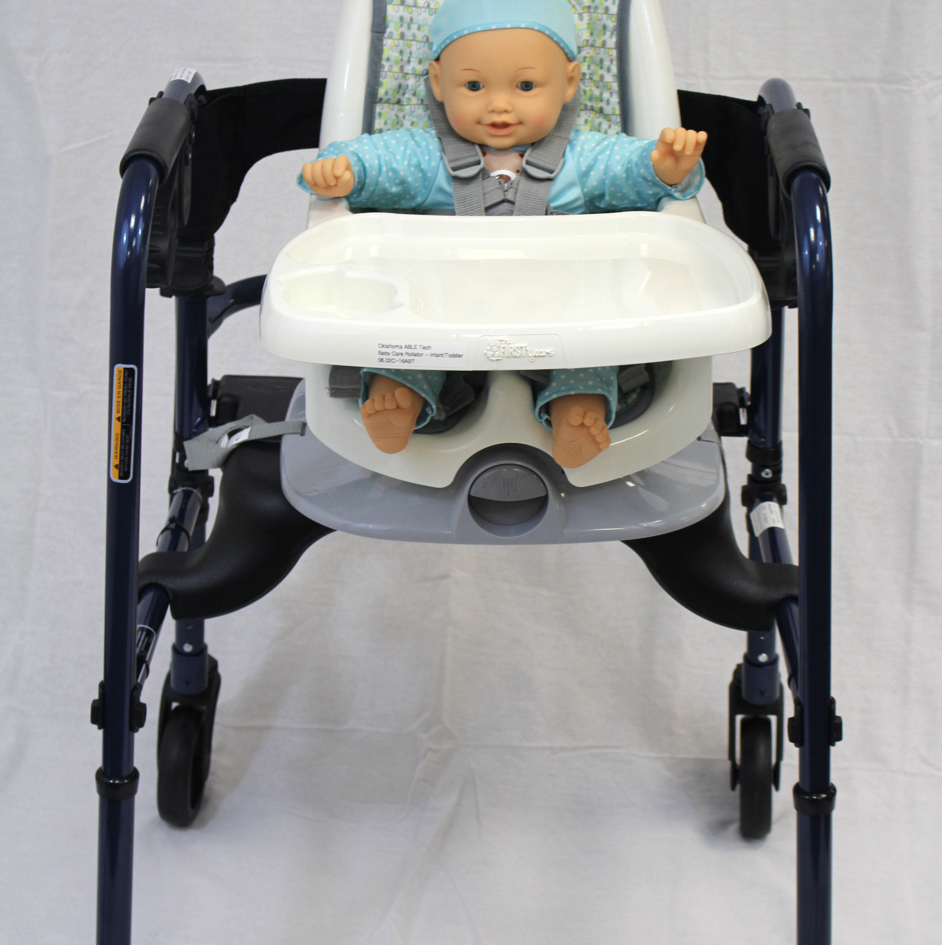
Baby Care Rollator – with feeding seat
Rollator walker with a feeding seat attached.
Useful for parents who have difficult carrying their child
Baby can be placed securely in the seat while parents use the walker for support as they walk.
For newborn children, a rollator with a bouncy seat attached is available.

Slide 11

DigiScan Infrared Talking Thermometer
Helpful for parents with visual impairments
Instantly speaks the temperature results
Red indicator lights when a fever is detected
May also be helpful for a parent with an intellectual disability

Slide 12
Assistive Technology for Parents with Disabilities
http://idahoat.org/Portals/60/Documents/Services/Resources/AT_ParentsHandbook.pdf and
http://idahoat.org/Portals/60/Documents/Services/Resources/AT_CognitiveImpairmentsHandbook.pdf
2 practical guides that offers room by room suggestions for technology that can help with parenting tasks. (LINK)
Source: The Idaho Assistive Technology Project

Slide 13
Discover the range of interactive tools, video guides, mobile apps and other products Raising Children Network offers parents and caregivers. Includes:
Our video guide shows common baby cues to help you understand your baby’s body language.
Watch some tricky parent and teen situations and explore how different approaches to communicating can get different results.
Interactive tool to learn how to keep your home safe for kids of different ages.
Explore key child development stages on video, with fun play ideas to boost your child’s learning from birth to eight years.
http://raisingchildren.net.au/interactive_tools/interactive_tools_landing.html
Parenting in Pictures
Articles on lots of basic parenting skills and situations with both words and pictures. Covers all ages.
http://raisingchildren.net.au/parenting_in_pictures/pip_landing_page.html

Slide 14
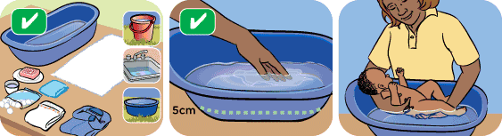


Checking for understanding
Use either/or questions instead of yes/no questions. An example of this is “Did that make you feel happy or sad?”
Include an option of answering “I don’t know” to questions and make sure the parent knows that it is ok to say this
Keep questions short and simple
Use some open-ended questions, e.g., “Tell me what you’ve been doing this week to practice the skills you’ve learnt in this program?”
Avoid statement or questions that have too much detail or are too complex
Ask factual questions that require immediate and concrete answers
Ask the parent to explain a comment you have just made, or to tell you more about it, e.g., “Tell me what it may feel like when labor starts”
Ask for examples to illustrate a comment
Ask how the parent is going to do the task
Use visuals

Slide 15
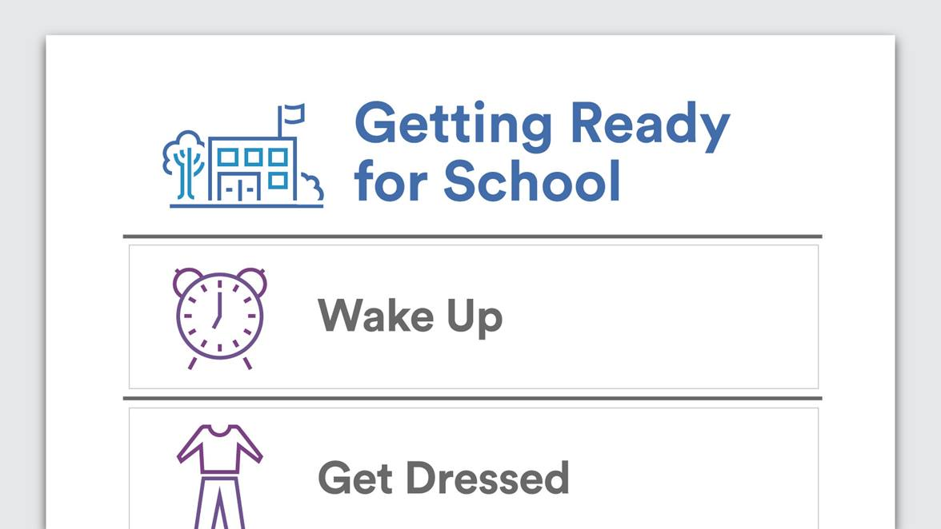

Slide 16
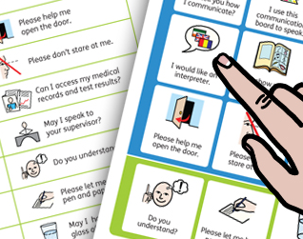
Medical Encounter Board
Medical encounters are fraught with communication pitfalls, and, for patients who have limited ability to speak or have a pre-existing condition limiting their communication capabilities, these pitfalls can be multiplied many times. Such patients need to have communication supports at the ready if and when they are not provided with adequate supports during medical encounters.
This is an easy-to-use and readily available resource for patients with communication vulnerabilities facing medical interactions and covers some of the most important phrases that patients wish to convey during medical visits, in emergency rooms, and in related health settings. (LINK)
https://widgit-health.com/download-files/medical-encounter-board/MEB-grid-A4.pdf
Notes:
This site has lots of different types of simple communication boards that may be helpful.

Slide 17
National Research Center for Parents with Disabilities, 2017. www.centerforparentswithdisabilities.org
Provides fact sheets and webinars designed specifically for parents with disabilities, prospective parents with disabilities, social workers, and lawyers. Lots of practical information
Know Your Rights: Advocacy Strategies for Parents with Disabilities
Deaf Parents' Approaches to Parenting
How Prospective Parents with Disabilities Can Prepare for Parenthood
Family Mental Health Begins with Parents
Working with Parents with Intellectual Disabilities and Their Families: Strategies and Solutions for Social Workers
Representing Parents with Intellectual Disabilities and their Families: Strategies and Solutions for Attorneys

Slide 18
Things the parents felt helped them:
Family members willing to show them how to do things and double check safety issues.
Adaptive equipment!
Access to occupational therapists
Help with organizing -- at home (baskets) or with appointments
Visual aides – pictures are your friend
Help with planning – lay out ALL the steps, teach routines
Information on where to find help and practical guidance
In home services solve the transportation issue

Slide 19
Healthy Bodies – A parents guide on puberty for girls & boys with disabilities from Vanderbilt University (free)
Puberty can be a stressful and confusing time for you and your child with an Intellectual and/or Developmental Disability (I/DD). In spite of delays in other areas, children with I/DD usually enter puberty around the same time as other children their age. Some children with I/DD, including children with spina bifida and cerebral palsy, may start puberty early (called precocious puberty). This toolkit gives you resources and tips on how to talk to your child about these sensitive topics.
The toolkit web version is a pdf version of the printed toolkit that you can print for your reference. Separate toolkits for boys and girls.
The toolkit appendix has storyboards and visuals that you can use in implementing the methods outlined in the toolkit. This file is not included in the printed manual. You may choose to print the entire appendix, or you may want to print a particular page or set of pictures to laminate for everyday use. You may share these pictures with others who work with or care for your child.
https://vkc.mc.vanderbilt.edu/healthybodies/index.html

Slide 20
Women Be Healthy
For training women with disabilities, Women Be Healthy is an 11-week, 22-hour educational curriculum for use by health educators and advocates. The curriculum teaches women with intellectual disabilities about breast and cervical cancer, recommended screenings, and techniques for coping with procedures and assertiveness in medical situations. The goal is to increase access to and receipt of recommended screenings. Women who participated showed significant improvements in health knowledge, behaviors, beliefs and coping strategies. The website also includes links to a series of YouTube videos developed for women with disabilities.
Audience: Health educators, disability advocates and women with disabilities
To learn more, visit http://lurie.brandeis.edu/women/index.html.
Click on the links below to access the YouTube videos:
Mammography: http://www.youtube.com/watch?v=jgTrbWUdclg
Pap Test: http://www.youtube.com/watch?v=s9ylkUuKcXQ&feature=relmfu
Screening Plans: http://www.youtube.com/watch?v=-FER-RCwZNA&feature=relmfu

Slide 21
SAFE: Safety Awareness for Empowerment
Developed by the Waisman Center - University of Wisconsin–Madison
University Center for Excellence in Developmental Disabilities (free)
For youth with special healthcare needs
Covers first aid (a frequent child welfare concern)
Teaches personal safety and healthy relationship skills to prevent victimization and exploitation
https://www2.waisman.wisc.edu/cedd/pdfs/products/health/SAFE.pdf

Slide 22


Teach about healthy relationships

Slide 23
Healthy Start for Me and My Baby
Healthy Start for Me and My Baby is an interactive educational resource designed for pregnant women with learning difficulties. This includes women with intellectual impairment, and women who experience learning difficulties due to lifelong social, educational and health disadvantage.
Healthy Start for Me and My Baby is designed to complement current practice and promote the health and wellbeing of pregnant women with learning difficulties by
providing accessible information about pregnancy and childbirth;
promoting informed choice and participation in health care; and
facilitating better communication with health professionals.
(free) Parent & facilitator PDF copies available by contacting Lisa at lisa-simmons@ouhsc.edu

Slide 24
“Moment of Need” Help
Expectation of the Parents with Disabilities Resource Team: (FLYER)
Discuss how services can be adapted to meet the family’s unique needs.
Recommend disability resources that may benefit the family.
Recommend community resources that may benefit the family and discuss ways to make the programs accessible to the parent.
Brainstorm solutions to specific challenges and/or safety concerns that the parent/family are facing.
Whenever possible, help identify or nurture potential long term supports within the parent’s natural environment or areas of interest.
PwDRT Team Contact Points: (see map on flyer)
DHS Region 1 (yellow) - Deana Wilson deana-wilson@ouhsc.edu
DHS Region 2 (orange) – Janet Wilson janet-m-wilson@ouhsc.edu
DHS Region 3 (red) - Lori Wathen lori-wathen@ouhsc.edu
DHS Region 4 (green) – sooner-success@ouhsc.edu
DHS Region 5 (blue) – Erin Strayhorn erin-strayhorn@ouhsc.edu
Notes:
If they call the 877 number and indicate they have a PwD case their call will be sent to Lisa Simmons, Project Coordinator.

Slide 25
Does it help?
Post consultation surveys from providers show:
97% of providers felt the team identified strategies and resources that could benefit the parent they were working with.
84% of providers felt the team identified strategies that would help build the parent’s natural support network.

Slide 26

Information ….. for you, the parents, their providers & their natural supports
Resource guide for providers supporting parents with disabilities (LINK)
http://soonersuccess.ouhsc.edu/ServicesPrograms/SupportingParentswithDisabilities.aspx
Supporting Oklahoma Parents with
Disabilities (LINK)
https://www.facebook.com/OKpwd/

Slide 27

Questions?
Lisa Simmons
Project Coordinator – Supporting Oklahoma Parents with Disabilities
Lisa-simmons@ouhsc.edu
580-603-1580

